Slide 1




How to Support your Child with Reading
Year 7 Parents’ Evening

Slide 2
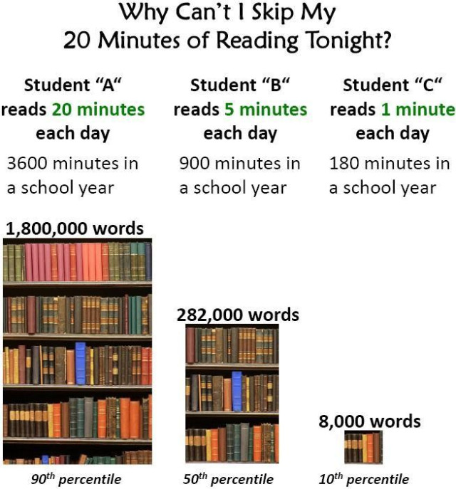
The importance of reading:
Reading regularly is not just important for your child to do well in English, but vital for them to succeed throughout their schooling and is a key life skill
Northampton Academy provides a wide range of opportunities for students to improve their reading skills including: Tutor Reading Programme, DEAR Time, Accelerated Reader
Students are assessed termly on their Reading Age (sent home in reports) and improvements have already been seen since the launch of the Tutor Reading Programme

Slide 3
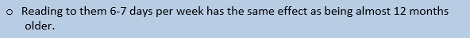
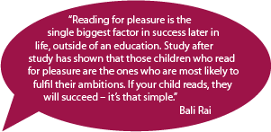
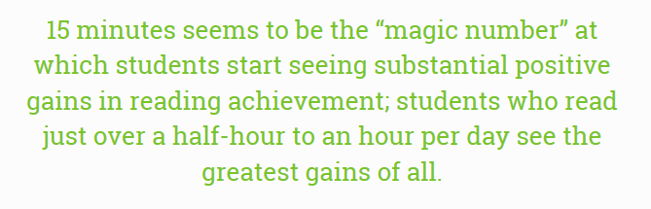
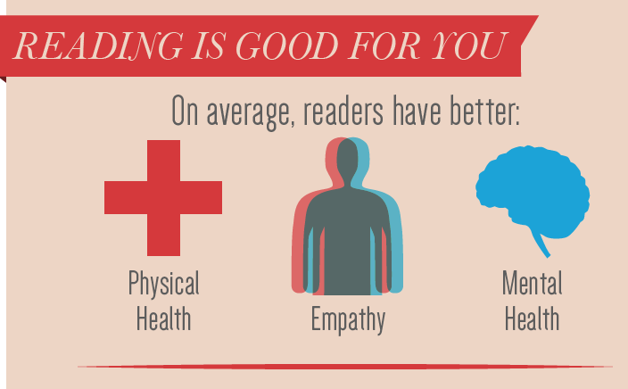
Research snapshots:
Scientists have found that children who have fiction read to them regularly find it easier to understand other people – they show more empathy and have better developed theory of mind (the ability to understand that other people have different thoughts and feelings to us, which is essential for understanding and predicting other people’s thoughts and behaviour).

Slide 4
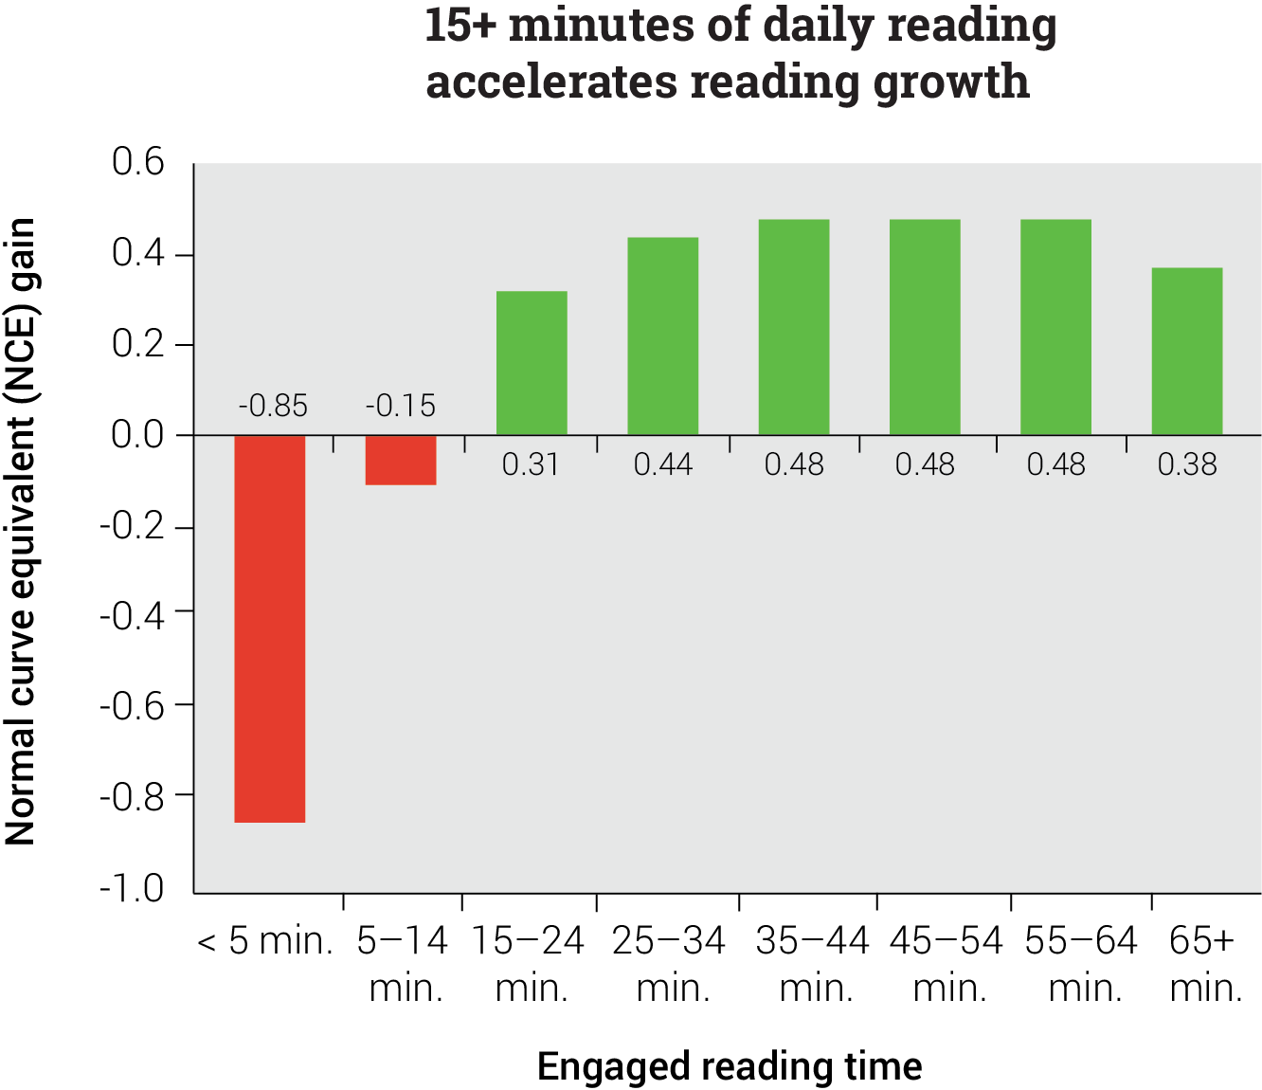
Benefits of increased daily reading:
An analysis comparing the engaged reading time and reading scores of more than 2.2 million students found that students who read less than five minutes per day saw the lowest levels of growth, well below the national average.² Even students who read 5–14 minutes per day saw sluggish gains that were below the national average.
Only students who read 15 minutes or more a day saw accelerated reading gains—that is, gains higher than the national average—and students who read just over a half-hour to an hour per day saw the greatest gains of all.
Please encourage your child to read at home, as well as in school

Slide 5
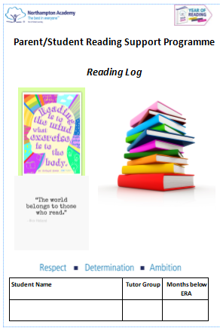
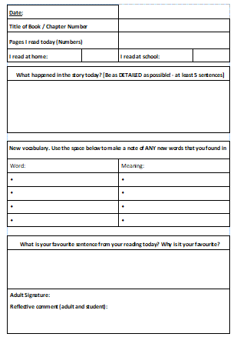
Reading Log:
For those students with a lower reading age, we offer a Reading Log programme to encourage students and parents to read aloud every day
This was launched last term and has already seen students on the programme make significant progress
Please feel free to take a Reading Log if your child doesn’t already have one

Slide 6
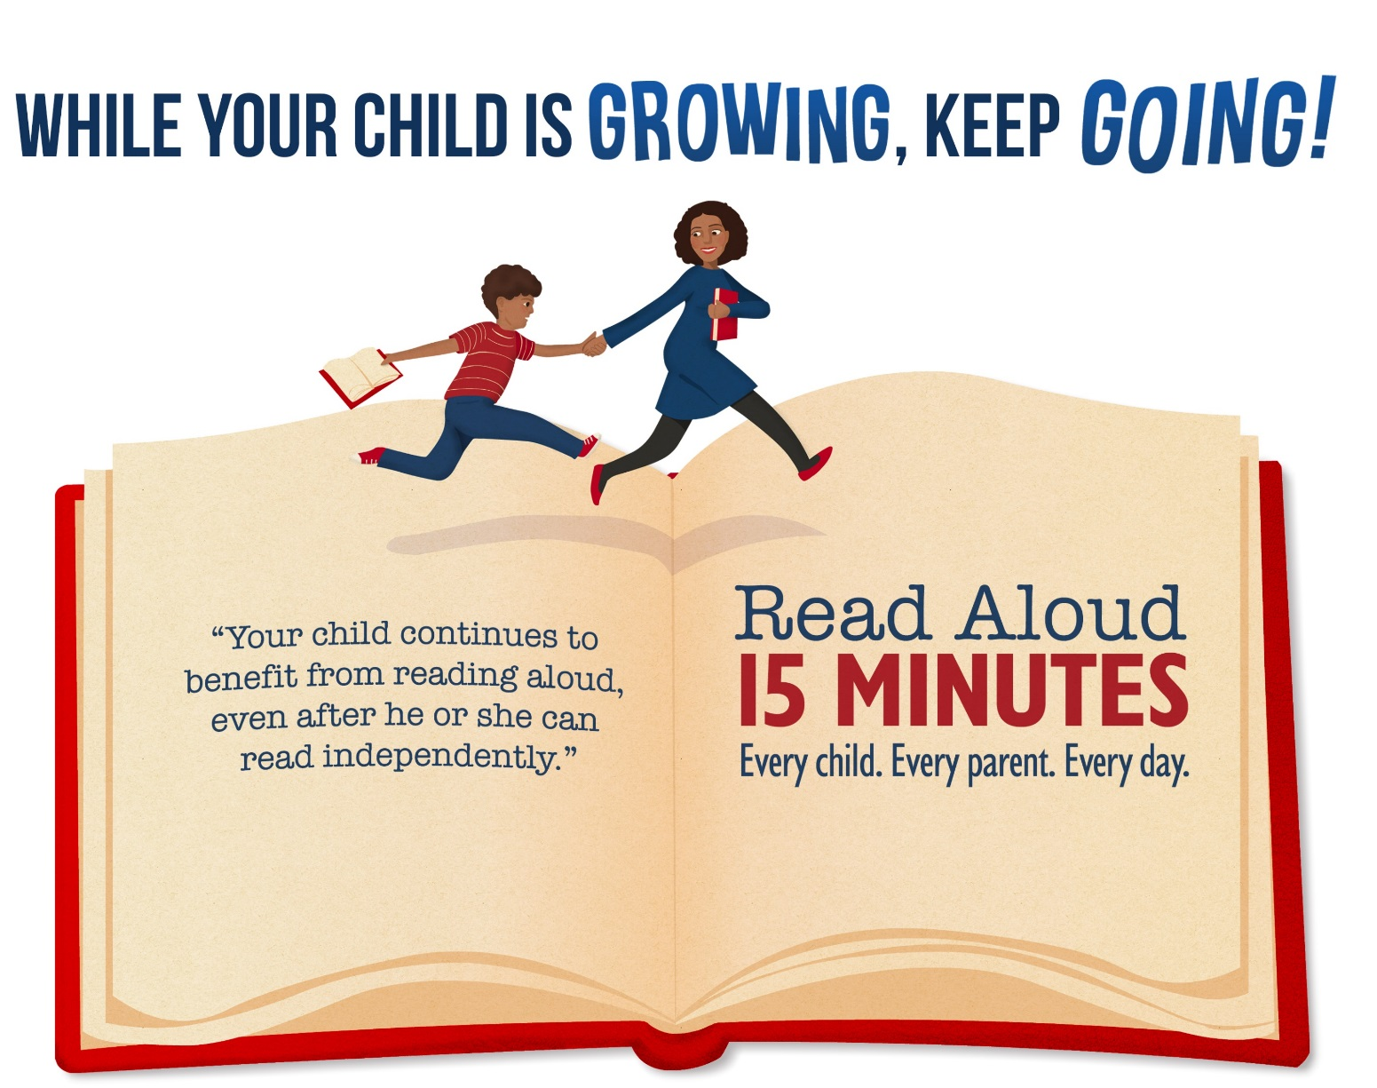
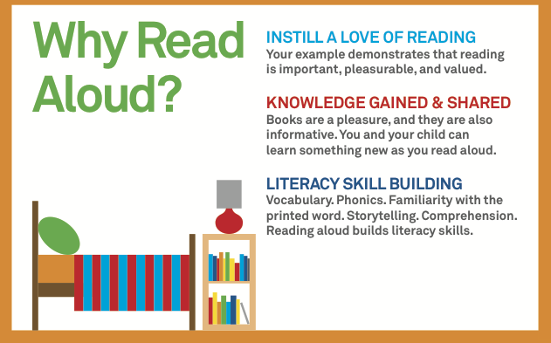
Why read with your child?
Did you know that the average reading age for a GCSE exam paper is 15.8 years?
To give your child the best possible chance of succeeding in their exams, we need to support them in matching or even exceeding this reading age

Slide 7

Top tips for reading with your child:
Choose a quiet and comfortable space – avoid busy areas where you might get disturbed by other family members
Make sure you choose a time where you don’t feel rushed
Ask your child why they chose this book and take an interest
Become a reading role model yourself – read in front of your child and regularly discuss what you’re reading. Involve the whole family!
Think of an appropriate method of incentivising/rewarding your child for reading at home

