Slide 1



The Power of Literacy
Why literacy isn’t just for English lessons……

Slide 2

What do we mean by ‘literacy’ anyway?
Literacy is the ability to read, write, speak and listen in a way that lets us communicate effectively and make sense of the world.

Slide 3

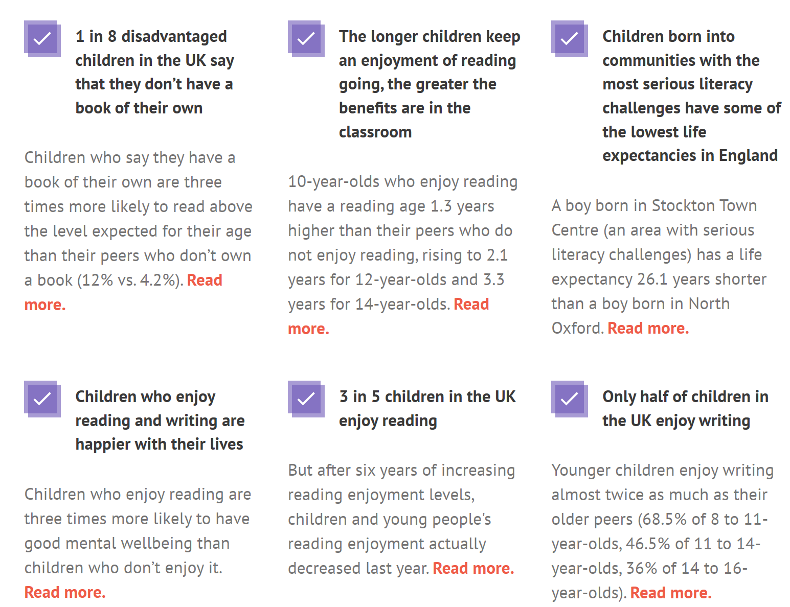
Why is literacy important?

Slide 4
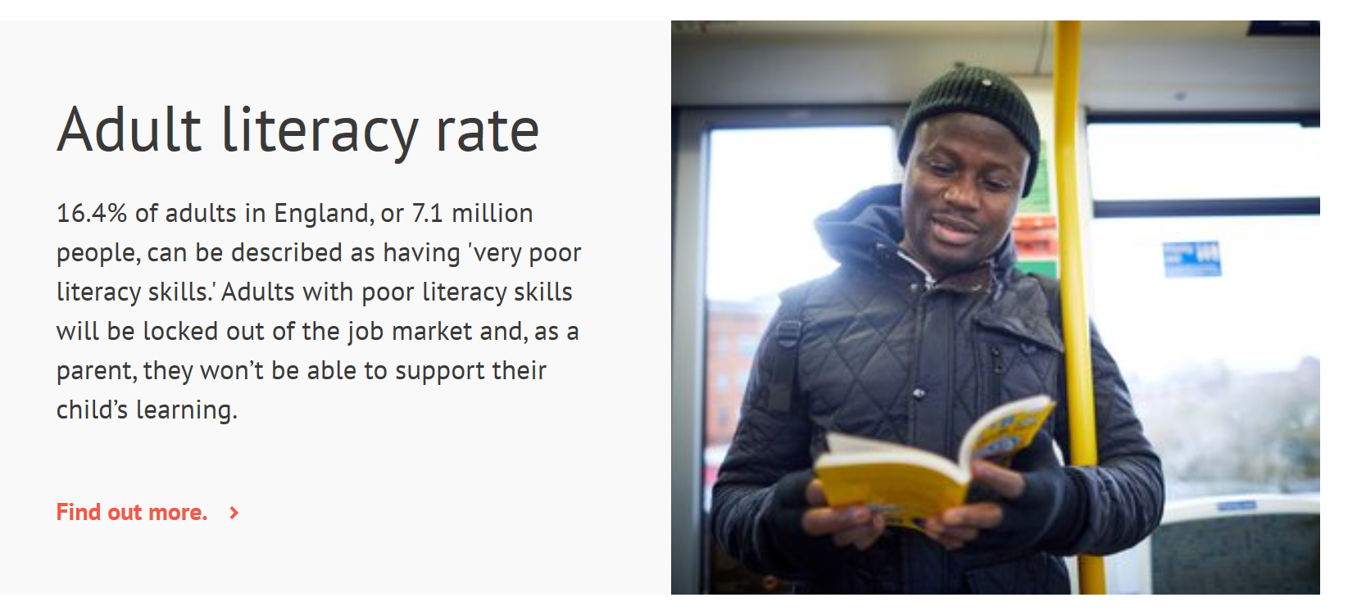
Literacy impacts your future
This is why it’s important to improve your literacy skills whilst still at school

Slide 5
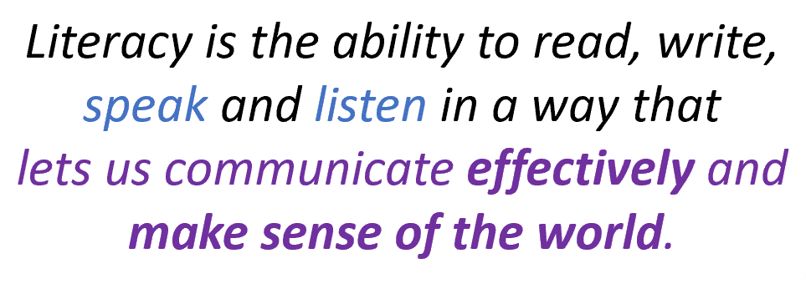
Literacy at Northampton Academy
During your time with us, we provide you with a variety of strategies to support your literacy:
Tutor Reading Programme (with new discussion cards)
DEAR Time
Library lessons and Accelerated Reader
Knowledge Organisers with subject specific terminology
Classroom discussion
Word of the Week
Extended written tasks
Student Voice
Reporting home reading age
Whole school events
And many more!

Slide 6


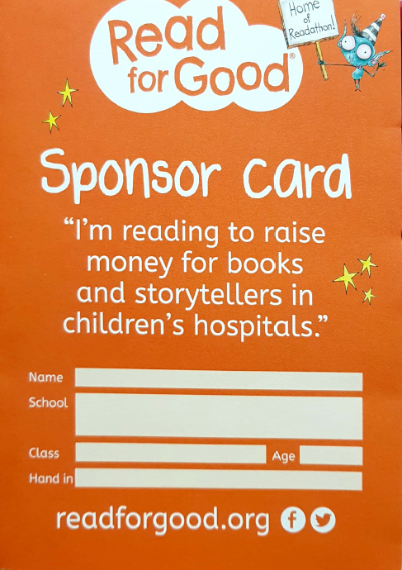

Literacy and Character: Readathon
Read for Good is a charity that runs Readathons in schools across the UK to raise money to provide books for children in your local hospital
Key info:
Collect your Sponsor Card and bookmark from English
You can be sponsored per book, per page or per 10 minutes!
You have until World Book Day – Thursday 5th March - to get your money submitted online
Respect
Determination
Ambition
Last year we raised over £200!
Notes:
https://www.youtube.com/watch?v=S2vUPYpaZK4

