Slide 1



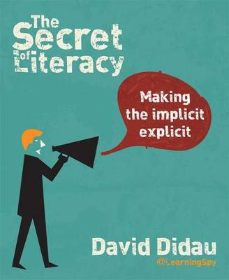

Supporting Literacy in the Classroom
Professional Studies - Wednesday 15th January
“Developing reading, writing and oracy are (or should be) absolutely fundamental to every teacher’s approach to pedagogy”
- David Didau

Slide 2
Session Outcomes:
To share best practice
To be informed by research
To take away some strategies to try in lessons
To be more confident in how to support Literacy

Slide 3

What do we mean by ‘literacy’ anyway?
Literacy is the ability to read, write, speak and listen in a way that lets us communicate effectively and make sense of the world.
What does this ‘look like’ in your subject areas?
What do you already do to support literacy?

Slide 4

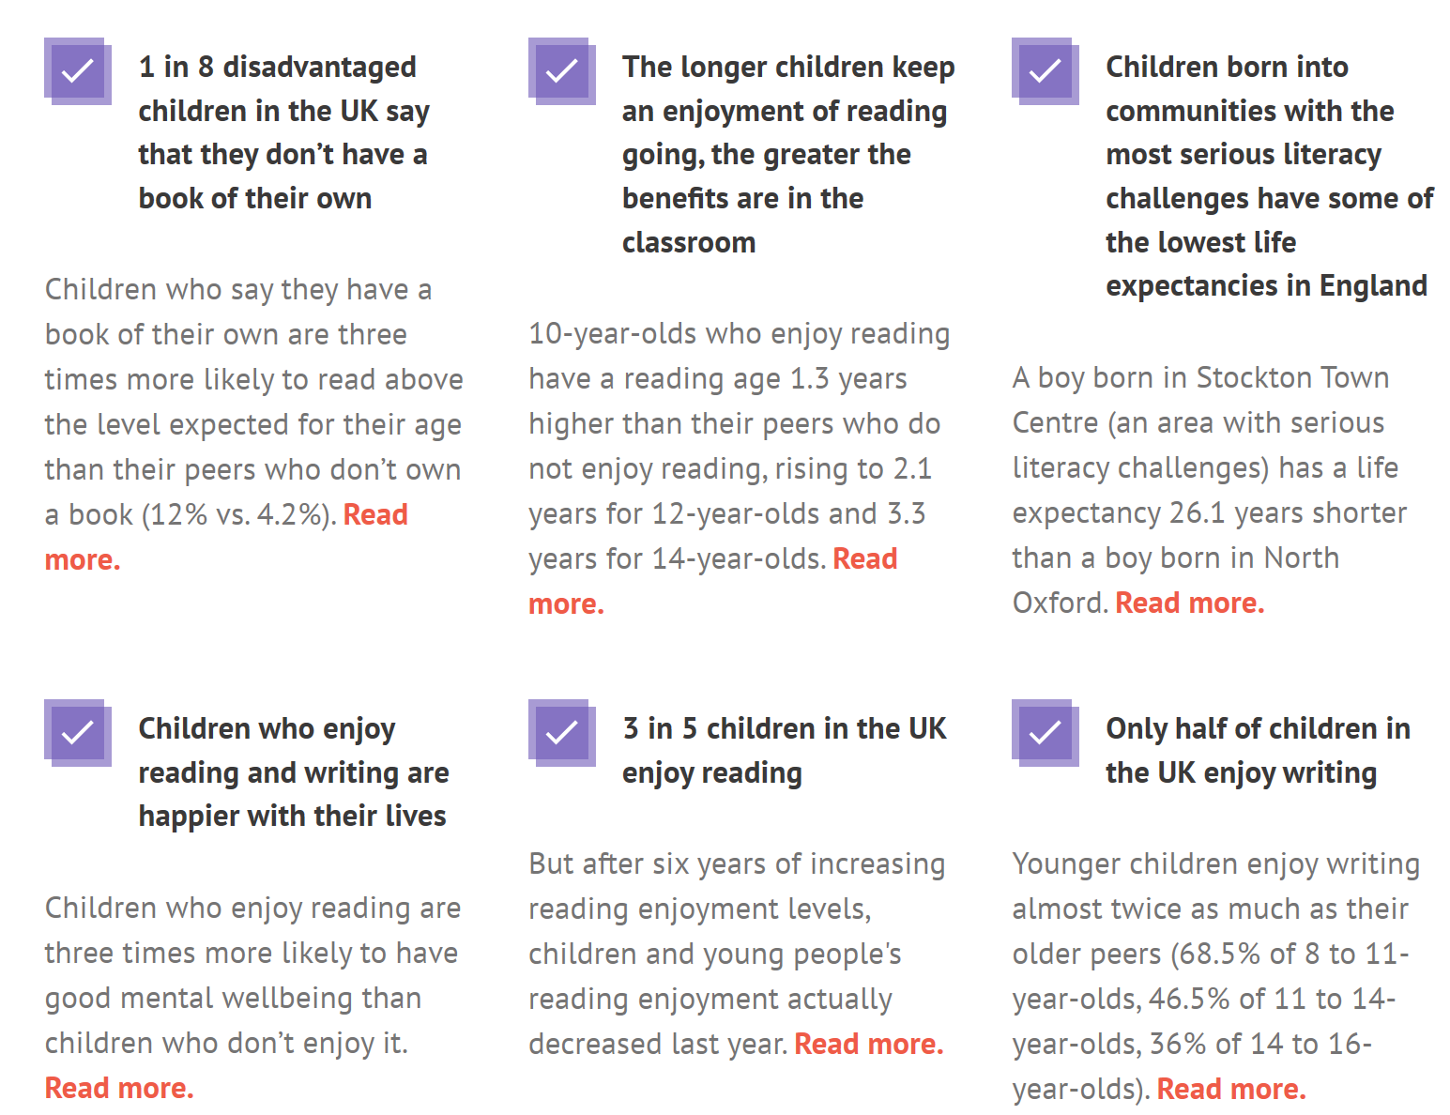
Why is literacy important?

Slide 5
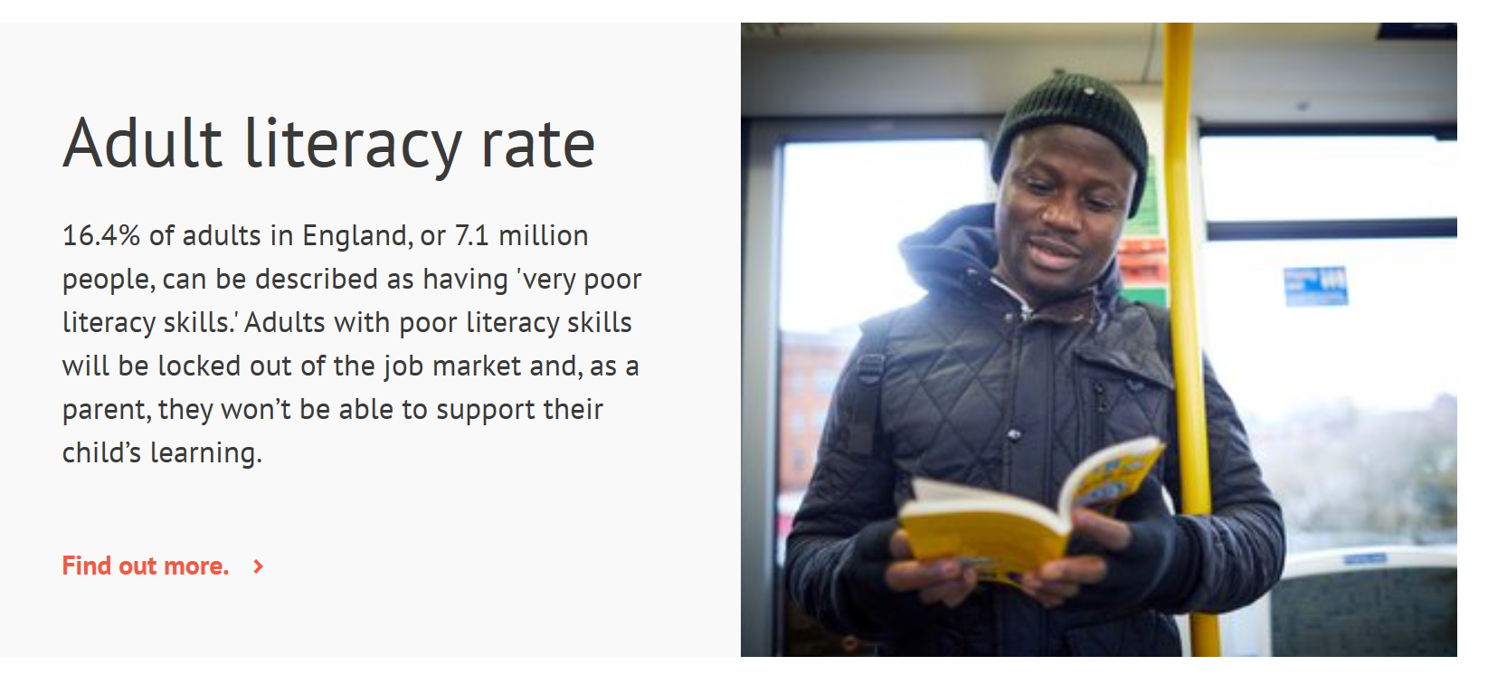
Literacy impacts your future:
This is why it’s important to support our students’ literacy

Slide 6

Students’ Reading Ages:
Please make yourself aware of the reading age of all of your students
A low reading age can be a massive barrier to student comprehension and achievement in all/any subject area
You can see reading ages on Class Charts
This student has a reading age of 12 years/3 months
(Over a year below his actual age)
Year 10 anecdote – ‘pity’

Slide 7
Vocabulary:
What % of words do you think we need to know in a text to ensure reading comprehension?
50% 60% 70% 80% 90%
We need to understand at least 90% of the vocabulary in a text before we can process it
- Hattie Visible Learning for Teachers

Slide 8
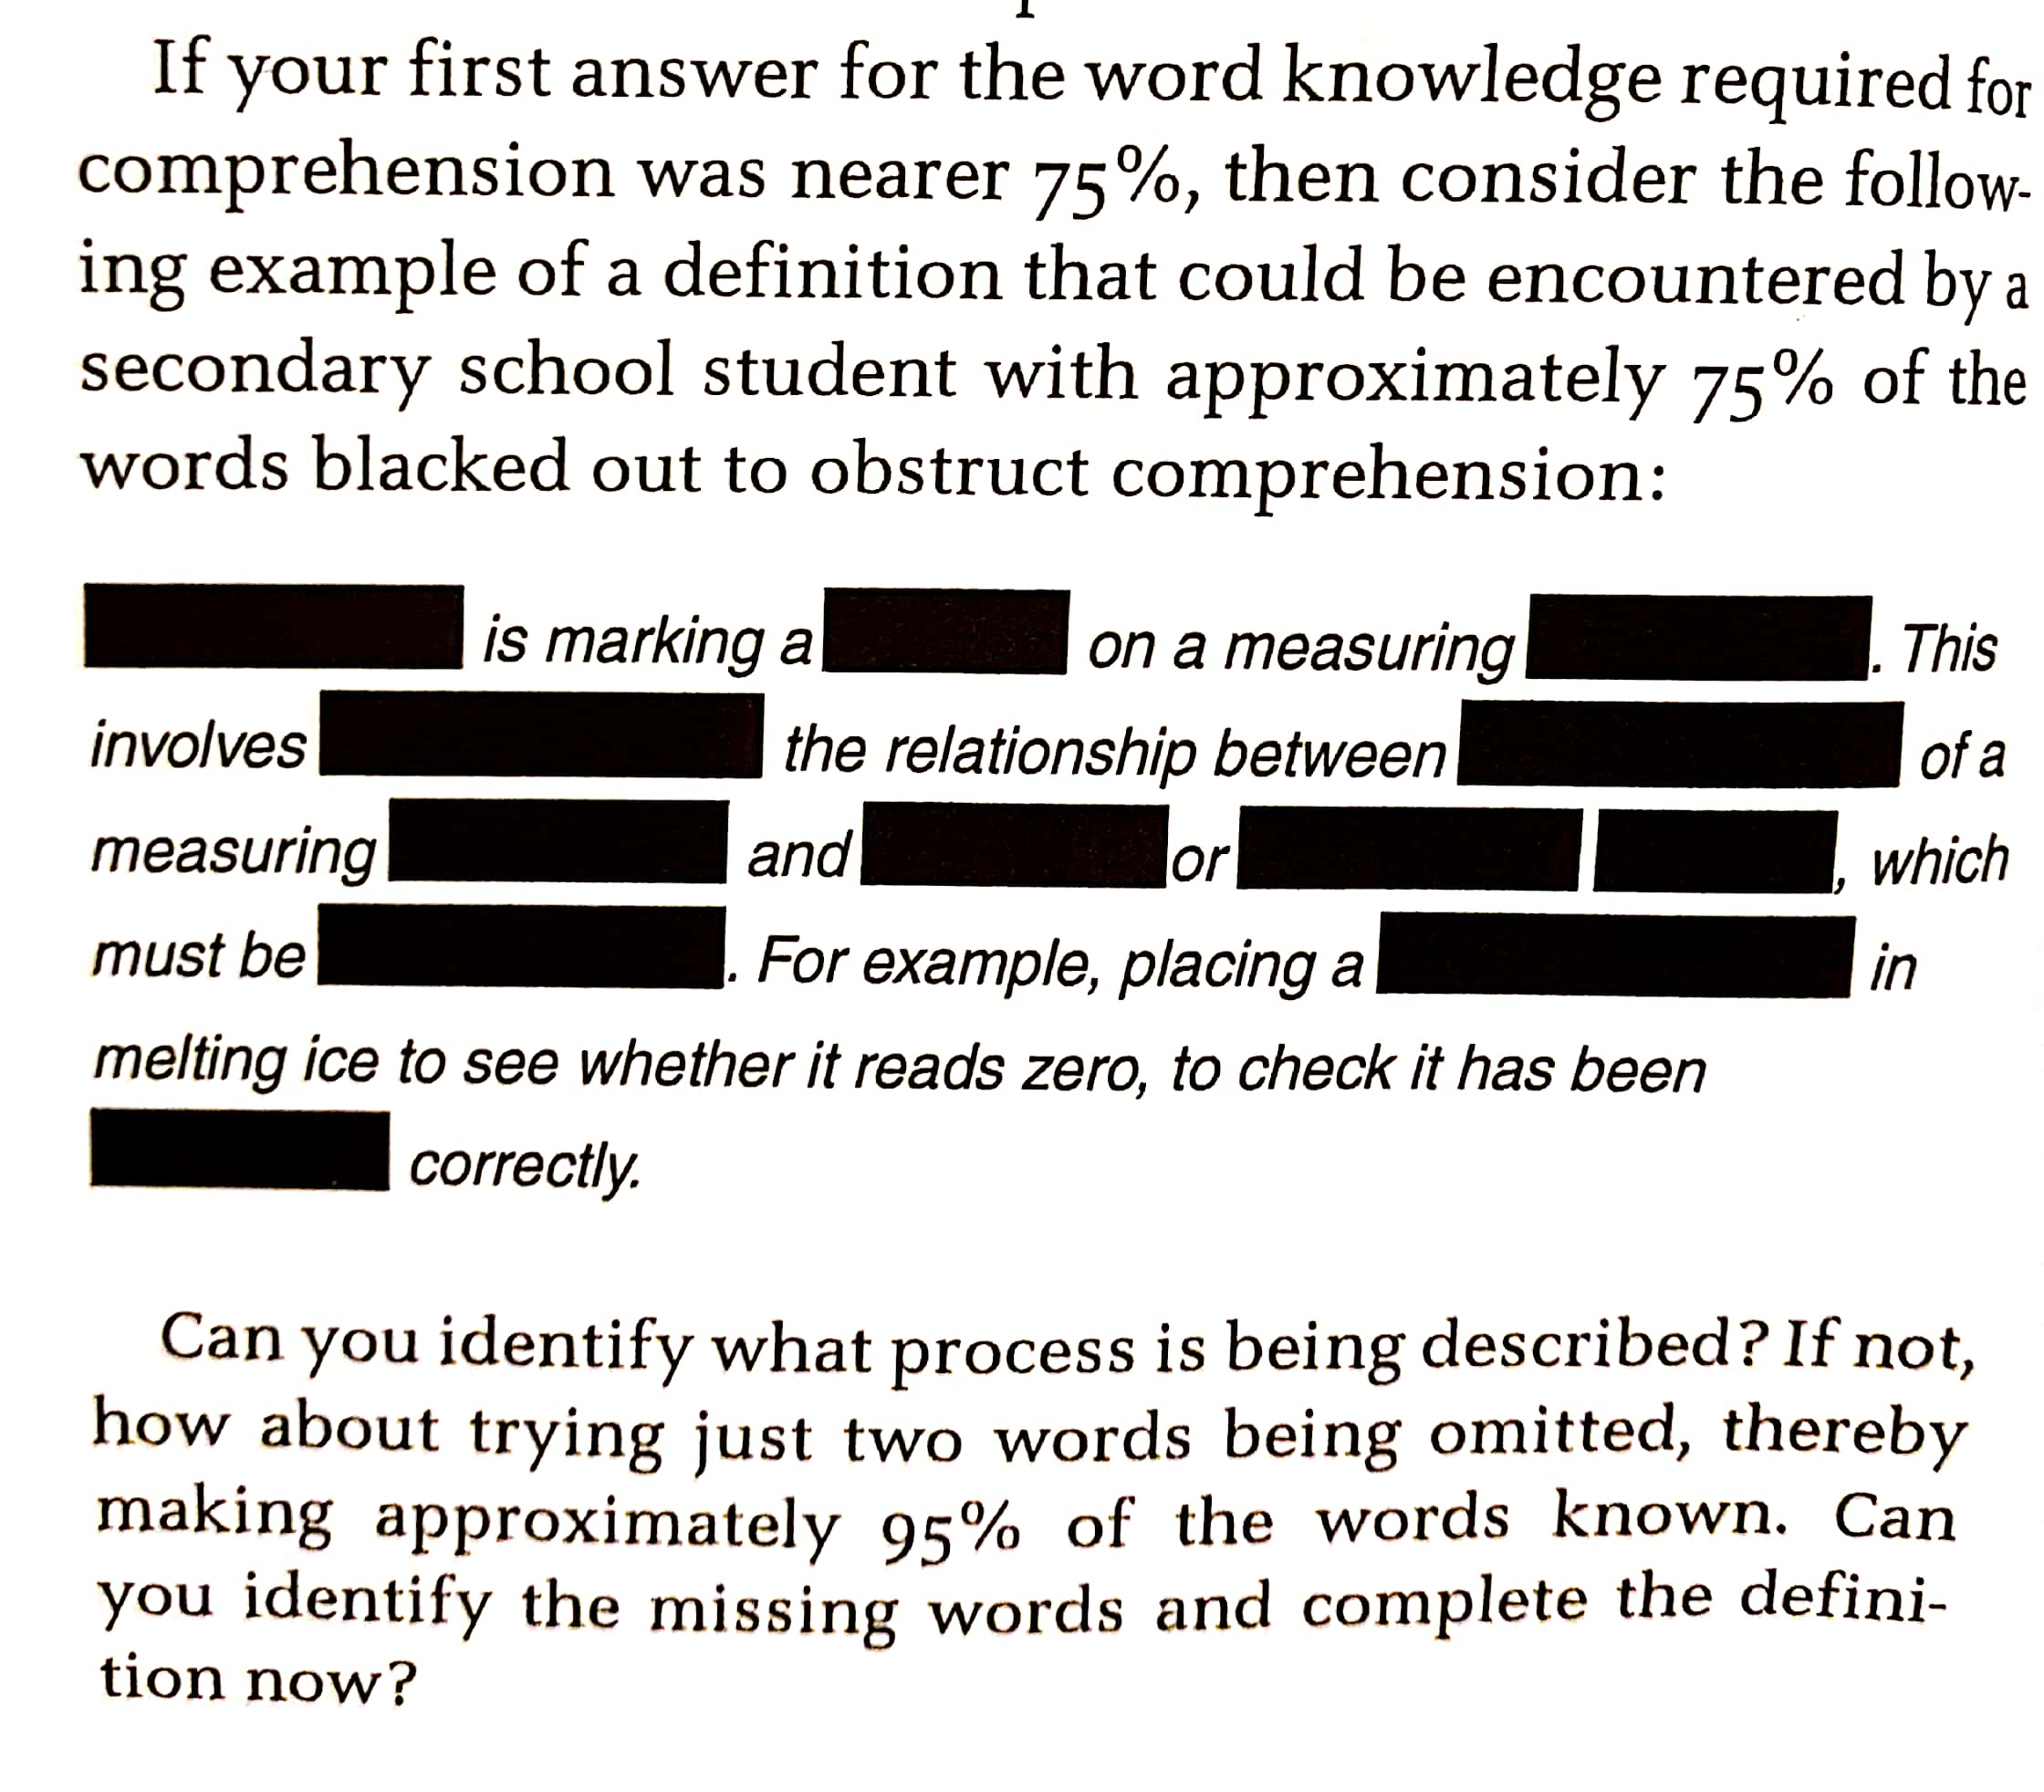
This is what your resources might look like to our word-poor students

Slide 9
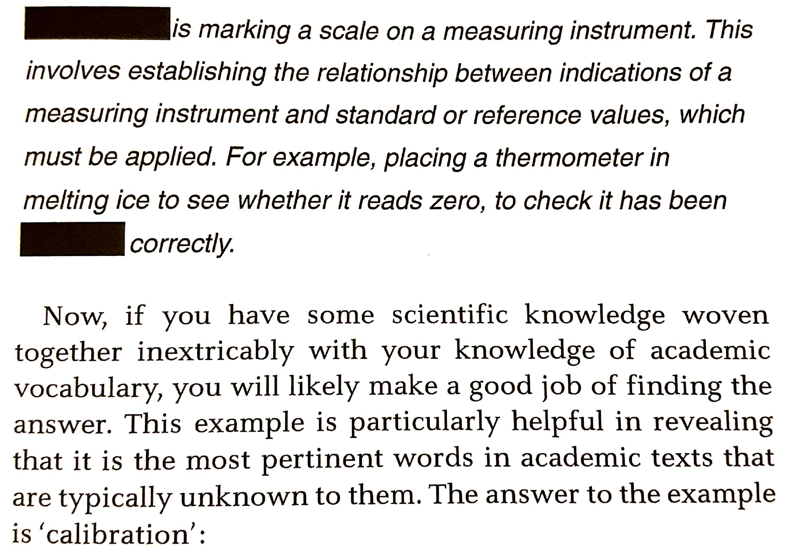

Slide 10
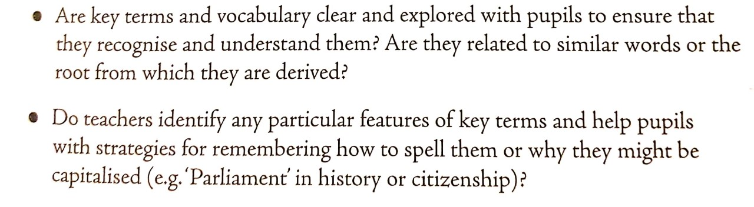
Make the implicit explicit:
David Didau states in his book that we need to explicitly teach the key vocabulary that students need in our lessons – we can’t just assume they know it
Use this checklist when planning lessons:

Slide 11
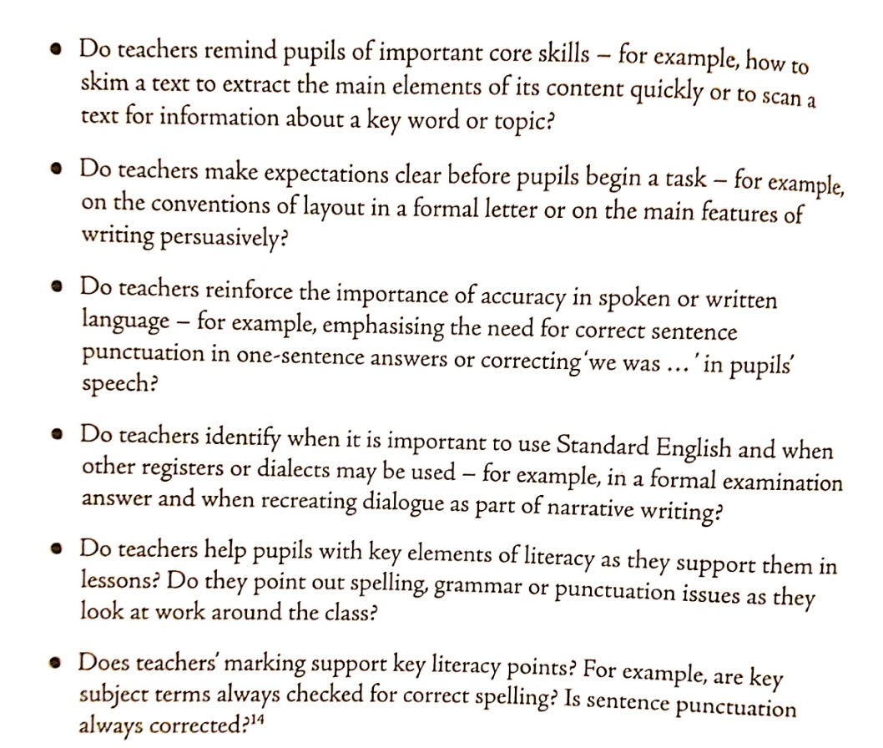

Slide 12
Oracy:
“We are only able to put into writing that which we can express verbally…we can only say what we think. And if you can’t think in academic language that means you’re not going to be able to speak in academic language either. But if we can say it, we can write it.”
So – how important do you think oracy is in the classroom?

Slide 13

“Rich structured talk is a solution to closing the vocabulary gap in our classroom. If this is twinned with high quality reading instruction, then we are well on the way to help children thrive with any curriculum.”
What do you already do to promote/improve oracy in your classroom?

Slide 14
Strategies for oracy:
Questioning is key!
Pose, Pause, Pounce, Bounce
The Socratic Method
Deeper Questioning
Before Before After After
Thought Stems
Look through your reading booklet to find out more about each strategy

Slide 15
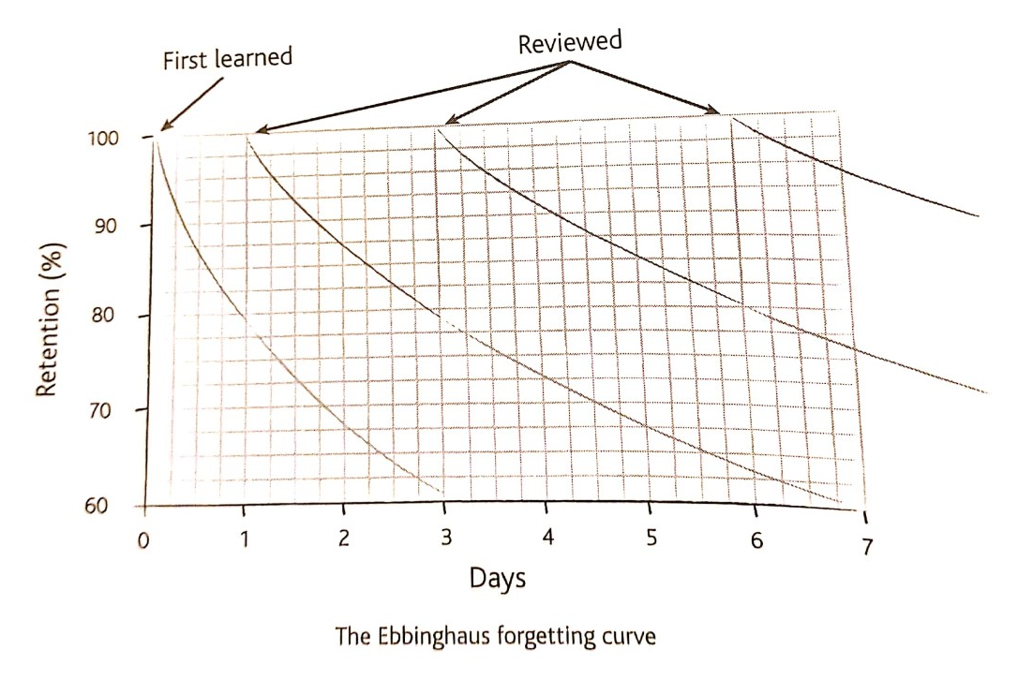
The forgetting curve:
Use bell work and plenaries to consolidate key vocabulary

Slide 16
Writing:
What type of writing do students need to do in your subject?
Give clear success criteria on the Genre, Audience and Purpose of the writing they will be using
Focus on the process of drafting and make sure you give lesson time for them to redraft and improve written work
Write alongside pupils in order to raise the importance and value of the task

Slide 17
So how do we teach vocabulary?
Explain – Explore - Consolidate
Explain:
Say the word carefully
Write the word
Give a student friendly definition
Give multiple meaningful examples
Ask for student examples to check for any misconceptions

Slide 18
Explore:
Explore the etymology of the word
Explore an common word families
Explore how the word might be used differently in different disciplines
Explore multi-choice questions that offer examples of the word in use
Explore understanding with peers – think/pair/share
Explore understanding with students restating the meaning in their own words
Explore further questions prompted by the word

Slide 19
Consolidate:
Test and learn
Typically, a child needs to encounter a new academic word multiple times to know that word with some depth of understanding
Using the word in the world
Give students the opportunity to use new words in the wider world as this can increase confidence
Research and record
Encourage students to research new words and create their own vocabulary bank

Slide 20
To summarise how to support literacy in your classroom:
Be aware of the reading ages of your students and adapt teaching/resources accordingly
Be explicit with what you expect from your students – in their writing and their speech
Don’t accept low standards – always challenge students’ use of speech/writing
Explicitly teach new vocabulary and regularly check for understanding (Rosenshine)
Promote high levels of oracy in your classroom
Be a Literacy Champion! Always use high quality speech and writing in your lessons

